Slide 1




RAISING AWARENESS ABOUT
PHISHING ATTACKS
By Aya El Ouarzazi

Slide 2
TABLE OF CONTENTS
Introduction to Phishing
Some Types of Phishing Attacks
How Phishing Attacks Work
Recognizing Phishing Attempts
Case Studies and Real-World Examples
Tips to Avoid Phishing Attacks
03
04
05
07
08
09

Slide 3

INTRODUCTION TO PHISHING
Definition of Phishing:
Phishing is a form of cyberattack where an attacker masquerades as a trusted entity to steal sensitive information such as login credentials, credit card numbers, or personal identification details.
The term "phishing" is derived from the word "fishing," implying that attackers are "fishing" for potential victims by luring them in with bait.

Slide 4



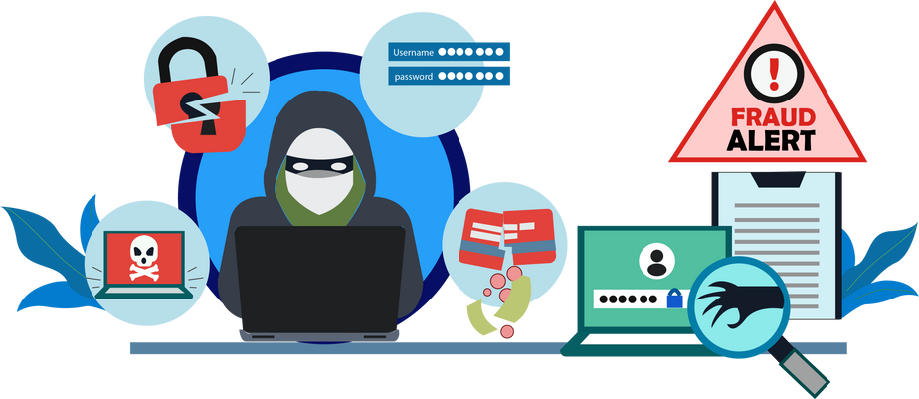



SOME TYPES OF PHISHING ATTACKS
EMAIL PHISHING
SPEAR PHISHING
SMISHING AND VISHING
The most common form, where attackers send emails that appear to be from legitimate sources to trick recipients into clicking malicious links or providing sensitive information.
A targeted attack directed at a specific individual or organization, often using personal information to make the attack more convincing.
The form of spear phishing that targets high-profile individuals such as executives or politicians is called whaling.
Phishing attempts made via SMS (smishing) or voice calls (vishing), often pretending to be from banks or other trusted entities.

Slide 5


HOW PHISHING ATTACKS WORK
Common Techniques Used in Phishing:
Email Spoofing
Attackers forge the sender's email address to make it look like it comes from a trusted source.
Link Manipulation
Phishing emails often contain links that appear legitimate but lead to fraudulent websites.
Website Forgery
Attackers create fake websites that mimic real ones to steal login credentials or personal information.
Malicious Attachments
Emails may contain attachments that, when opened, install malware on the victim's device.

Slide 6


Anatomy Of Phishing Attacks
01
02
03
Phishing Email
Phishing Websites
Social Engineering:
Subject Line: Often includes urgent language such as "Immediate Action Required" or "Account Suspended."
Sender's Address: May look legitimate but could have slight misspellings or be a completely different email that resembles a known one.
Body of the Email: Contains a message that prompts the recipient to take action, such as clicking a link or downloading an attachment.
Links: Hovering over links may reveal a different URL than what is displayed, often a sign of phishing.
Attachments: Files that appear as PDFs, invoices, or other documents but could contain malware.
URL Manipulation: Attackers use URLs that are similar to legitimate ones but have slight variations (e.g., using ".net" instead of ".com").
Visual Cloning: The website’s design and layout are cloned from the legitimate site, making it difficult to distinguish.
SSL Certificates: Some phishing sites may even have SSL certificates (indicated by HTTPS), falsely implying security.
Pretexting: Attackers create a fabricated scenario to steal information (e.g., posing as an IT support person).
Baiting: Enticing victims with something they want, such as free downloads or attractive offers, to gain access to their information.
Quid Pro Quo: Offering a service or benefit in exchange for information.
Impersonation: Pretending to be someone the victim knows or trusts, such as a colleague or a family member.

Slide 7





RECOGNIZING PHISHING ATTEMPTS
IDENTIFYING SUSPICIOUS EMAILS:
Unfamiliar Sender
Generic Greetings
Spelling and Grammar Mistakes
Unsolicited Attachments
ANALYZING URLS FOR LEGITIMACY:
Hover Over Links
Look for Misspellings
Domain Extensions
UNDERSTANDING THE PSYCHOLOGY BEHIND PHISHING:
Fear and Urgency
Greed and Curiosity
Authority

Slide 8




CASE STUDIES AND REAL-WORLD EXAMPLES
Spear phishing emails were used to deliver malware that led to a massive data breach, exposing sensitive employee information and unreleased films. The Sony hack underscored the need for comprehensive employee training on phishing and social engineering.So Sony enhanced their incident response plan and invested in cybersecurity training for employees
Attackers gained access to Target’s network via a phishing email sent to a third-party vendor, compromising millions of customer records. The Target breach highlighted the need for strong security measures across the supply chain. So Target strengthened their cybersecurity infrastructure and implemented more rigorous vendor management practices
A Lithuanian hacker used phishing emails to impersonate a supplier and tricked both companies into transferring over $100 million. The Google and Facebook incident emphasized the importance of verifying payment requests, especially when they involve large sums of money sothe two companiesImproved their internal controls for financial transactions and implemented stricter verification processes.

Slide 9


TIPS TO AVOID PHISHING ATTACKS
Be Skeptical of Urgent Requests: Phishing emails often create a sense of urgency, pressuring you to act quickly. Always take a moment to think before clicking any links or providing information.
Verify the Source: If you receive an unexpected email or message from a known entity asking for sensitive information, contact the source directly using a known, legitimate method.
Check Email and URL Details: Look for inconsistencies in email addresses, URLs, and domain names. Small changes like "rn" instead of "m" can indicate a phishing attempt.
Avoid Clicking on Links: If you receive an unsolicited email with links, don't click on them. Instead, type the URL directly into your browser to ensure you’re going to the correct site.
Use Security Software: Install and regularly update antivirus and anti-phishing software. These tools can help detect and block phishing attempts.
Enable Two-Factor Authentication (2FA): This adds an extra layer of security by requiring two forms of verification before granting access to an account.
Report Suspicious Emails: If you receive a phishing email, report it to your IT department or use the "Report Phishing" feature in your email client.

Slide 10

THANK YOU!
AND REMEMBER
AWARENESS IS
YOUR DEFENSE;)
✍️:Aya El Ouarzazi

